Slide 1
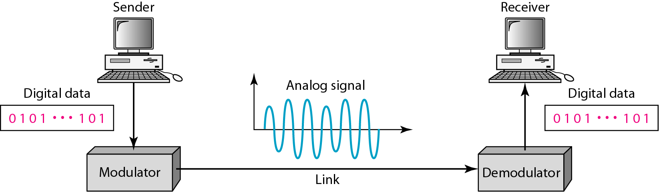
Digital to Analog Signal
One of the characteristics of the analog signal is changed based on the information in the digital data.
The characteristics are:-
Amplitude
Phase
Frequency

Slide 2
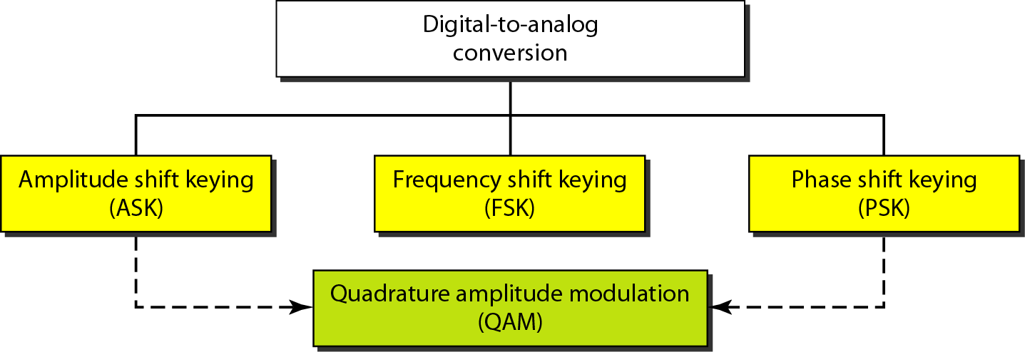
Types of Digital to Analog Conversion

Slide 3
Digital to Analog Signal
Digital data to analog signal conversion techniques:-
Amplitude Phase Keying: Amplitude will be varied according to the information on digital data.
Phase Shift Keying: Phase will be varied according to the information on digital data.
Frequency Shift Keying: Frequency will be varied according to the information on digital data.
Quadrature Amplitude Modulation (QAM): Both amplitude and phase will be varied according to the information on digital data.

Slide 4
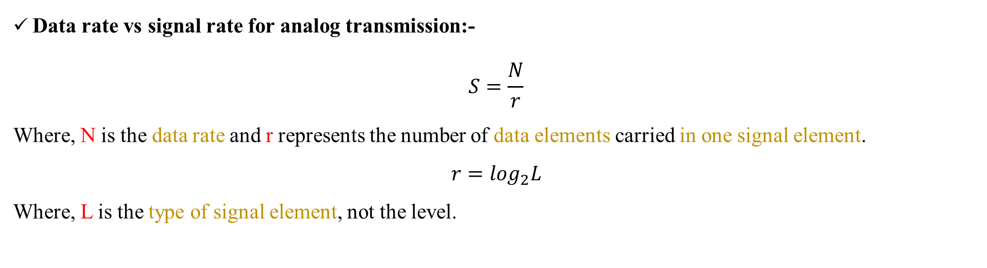
Digital to Analog Signal
Data rate vs signal rate for analog transmission:-
$$S=\frac{N}{r}$$
Where, N is the data rate and r represents the number of data elements carried in one signal element.
$$r=\log_{2}L$$
Where, L is the type of signal element, not the level.

Slide 5
Example 5.1: An analog signal carries 4 bits per signal element. If 1000 signal elements are sent per second, find the bit rate.
Solution: In this case, r = 4, S = 1000, and N is unknown. We can find the value of N from

Slide 6
Example 5.2: An analog signal has a bit rate of 8000 bps and a baud rate of 1000 baud. How many data elements are carried by each signal element? How many signal elements do we need?
Solution: In this example, S = 1000, N = 8000, and r and L are unknown. We find first the value of r and then the value of L.

Slide 7
Digital to Analog Signal
Carrier Signal
In analog transmission, the sending device produces a high frequency signal that acts as a base for the information signal. This base signal is called carrier signal.
Shift Keying (Modulation)
Digital information then changes the carrier signal by modifying one or more of its characteristics (amplitude, frequency or phase). This kind of modification is called modulation (shift keying).

Slide 8
Digital to Analog Signal
Amplitude Shift Keying (ASK)
ASK is implemented by changing the amplitude of a carrier signal to reflect amplitude levels in the digital signal.
The amplitude of the carrier signal varies according to the amplitude of the message signal.
Multiplier
1
0
1
1
1
0
Message Signal
Modulated Signal (ASK)
Carrier Signal

Slide 9
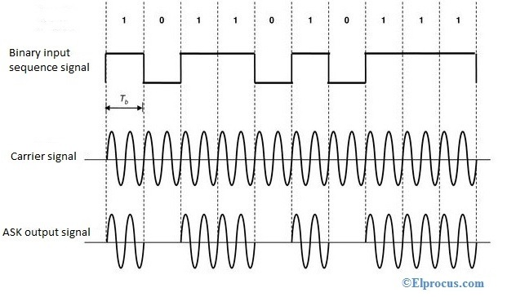
Digital to Analog Signal
Amplitude Shift Keying
It uses only two levels so it is also called binary amplitude shift keying (BASK) or on-off keying (OOK).
Bit 1- Amplitude same as carrier signal
Bit 0 – Amplitude 0

Slide 10
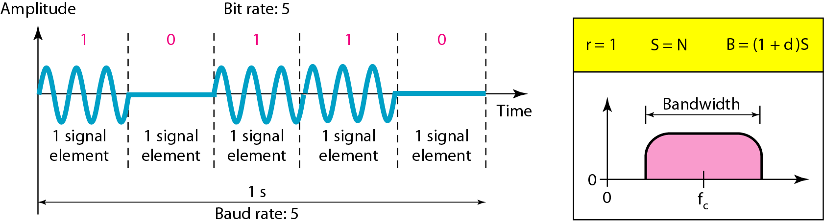
Digital to Analog Signal
Amplitude Shift Keying
The bandwidth B of ASK is proportional to the signal rate S.
B = (1+d)S.
“d” is due to modulation and filtering, lies between 0 and 1.

Slide 11
Example 5.3: We have an available bandwidth of 100 kHz which spans from 200 to 300 kHz. What are the carrier frequency and the bit rate if we modulated our data by using ASK with d = 1?
Solution: The middle of the bandwidth is located at 250 kHz. This means that our carrier frequency can be at fc = 250 kHz. We can use the formula for bandwidth to find the bit rate (with d = 1 and r = 1).

Slide 12
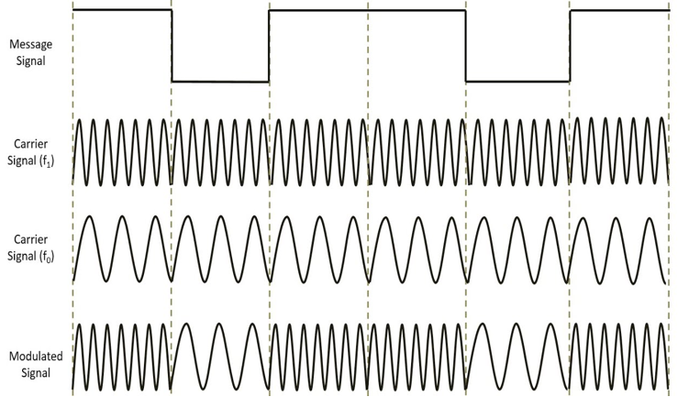
Digital to Analog Signal
Frequency Shift Keying
The frequency of the carrier signal is varied to represent data.
1
0
1
1
0
1
Bit 1 - Frequency same as carrier-1 signal
Bit 0 - Frequency same as carrier-2 signal

Slide 13
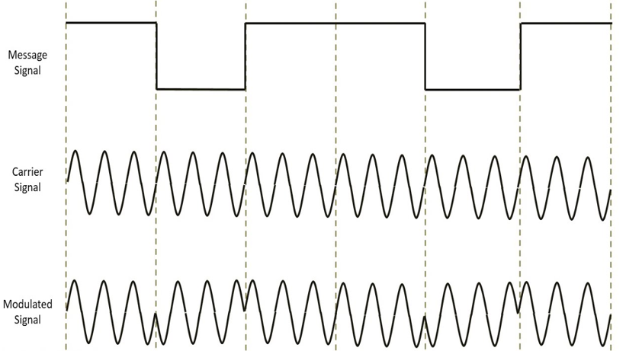
Digital to Analog Signal
Phase Shift Keying
The phase of the carrier signal is varied to represent data.
1
0
1
1
0
1
Bit 1- Phase 0 degree
Bit 0 – Phase 180 degree

Slide 14
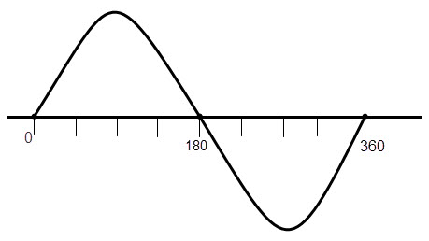
Digital to Analog Signal
Quadrature Phase Shift Keying (QPSK)
It is a form of PSK where two bits are modulated at once.
It selects one of four possible carrier phase shifts 0, 90, 180 and 270 degrees.
Where,
00 | Phase 0 degree
10 | Phase 90 degree
01 | Phase 180 degree
11 | Phase 270 degree

Slide 15
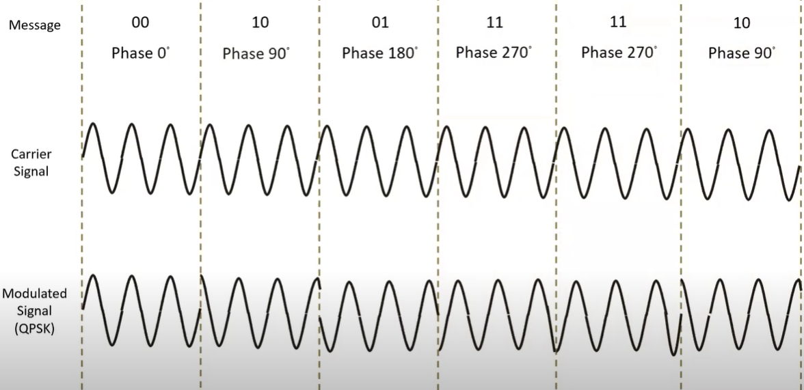
Digital to Analog Signal
Quadrature Phase Shift Keying (QPSK)

Slide 16
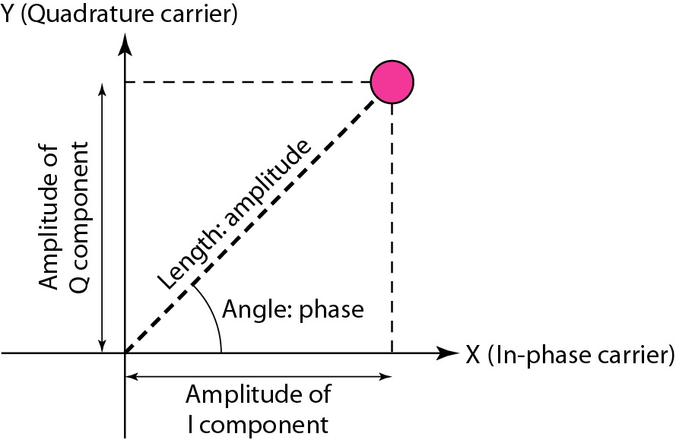
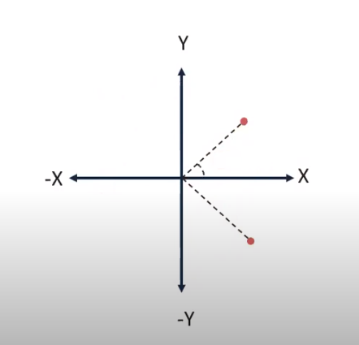
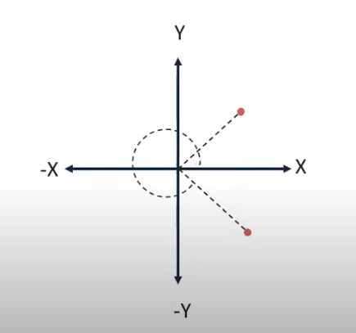
Digital to Analog Signal
Constellation Diagram
It is a representation of a signal modulated by a modulation scheme such quadrature amplitude modulation of phase shift keying(PSK).
It displays the signal as two dimensional XY- plane scatter diagram.
The distance of a point from the origin represents the measure of amplitude.
The angle of a point, measured counter clockwise from the horizontal axis, represents the phase shift of carrier wave.
The diagram has two axes. The horizontal X axis is related to the in-phase carrier; the vertical Y axis is related to the quadrature carrier.

Slide 17
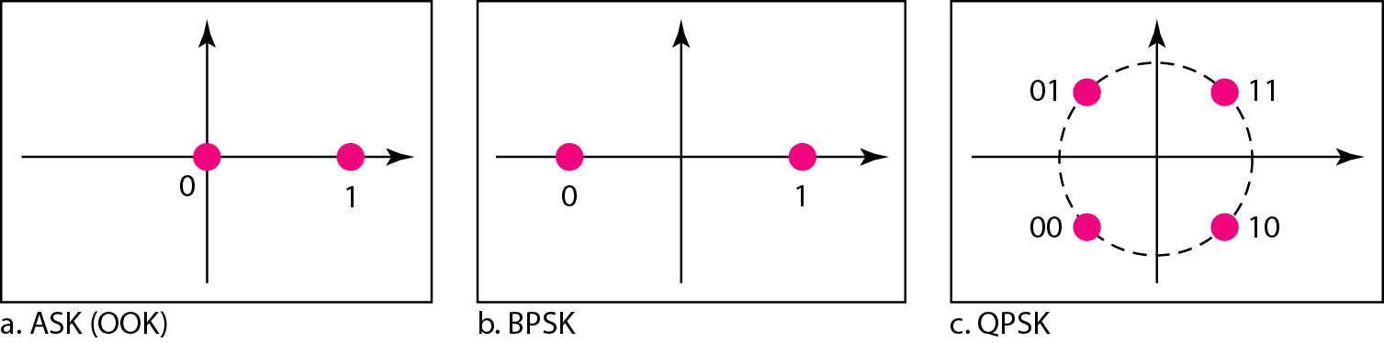
Digital to Analog Signal
Constellation Diagrams for ASK, BPSK and QPSK
00- Phase -135 degree
10- Phase -45 degree
01- Phase 135 degree
11- Phase 45 degree
1- Phase 0 degree
0- Phase 180 degree

Slide 18
Digital to Analog Signal
Constellation Diagrams for QPSK
00- Phase 0 degree
10- Phase 90 degree
01- Phase 180 degree
11- Phase 270 degree
Y
10
-X
X
01
00
11
-Y

Slide 19
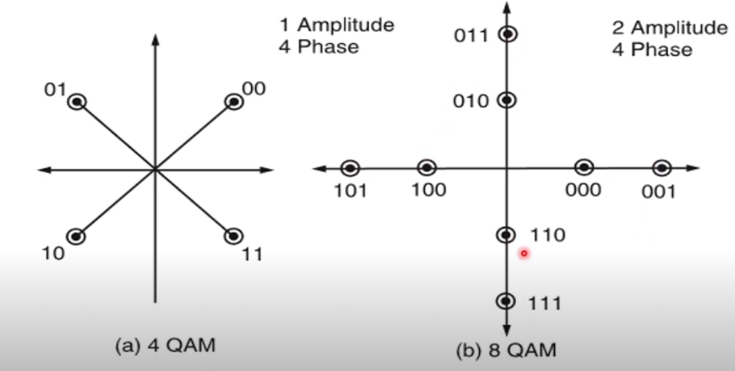
Digital to Analog Signal
Quadrature Amplitude Modulation (QAM)
Quadrature amplitude modulation is a combination of ASK and PSK.
The idea of using two carriers, one in phase and another in quadrature, with different amplitude levels for each carrier is the concept behind QAM.
The possible variations of QAM’s are numerous.
Constellation Diagrams for QAM

Slide 20
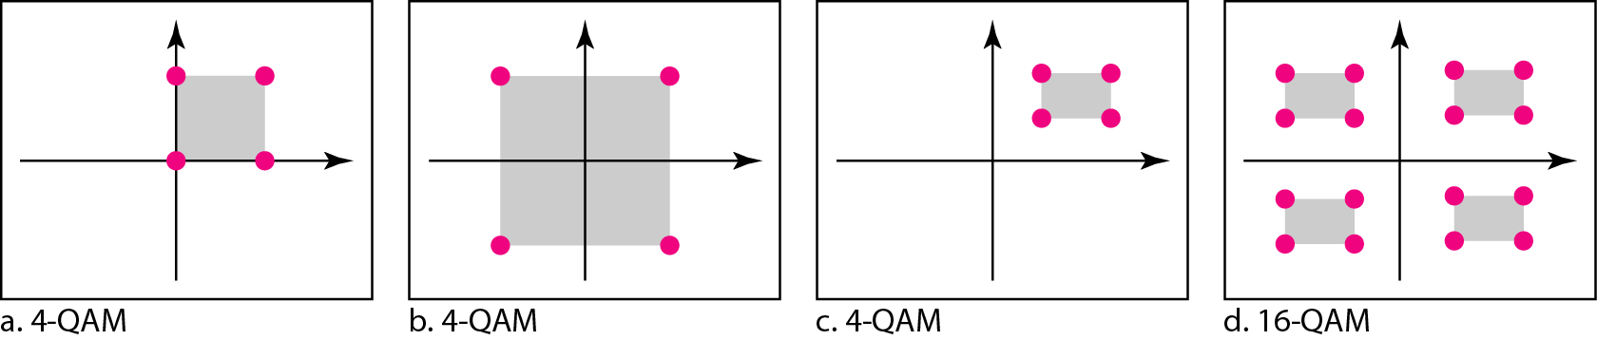
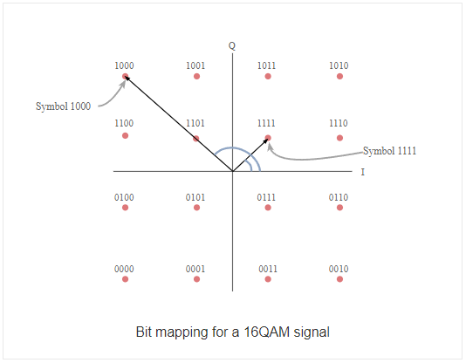
Digital to Analog Signal
Constellation Diagrams for QAM

Slide 21
Analog to Analog Conversion
Analog-to-analog conversion is the representation of analog information by an analog signal. One may ask why we need to modulate an analog signal; it is already analog.
Modulation is needed if the medium is bandpass in nature or if only a bandpass channel is available to us.
An example is radio. The government assigns a narrow bandwidth to each radio station.
The analog signal produced by each station is a low-pass signal, all in the same range. To be able to listen to different stations, the low-pass signals need to be shifted, each to a different range.

Slide 22
Why Modulation is needed??
A message signal cannot travel a long distance because of its low signal strength.
In addition to this, physical surroundings, the addition of external noise and travel distance will further reduce the signal strength of a message signal.
So in order to send the message signal to a long distance, we need to increase the signal strength of a message signal.
This can be achieved by using a high frequency or high energy signal called carrier signal.
A high energy signal can travel to a larger distance without getting affected by external disturbances.
We take the help of such high energy signal to transmit the message signal. This high energy or high frequency signal is known as carrier signal.
The low energy message signal is mixed with the high energy or high frequency carrier signal to produce a new high energy signal which carries information to a larger distance.

Slide 23
What is modulation?? How It is Performed??
The question arises how the message signal should be added to the carrier signal. The solution lies in changing some characteristics (amplitude, frequency or phase) of a carrier signal in accordance with the amplitude of the message signal. This process is called modulation. Modulation means to “change”.
The Message signal contains information whereas the carrier signal contains no information. Carrier signal is used just to transmit the information to a long distance. At the destination, the message signal is consumed whereas the carrier signal is wasted.
In modulation process, the characteristics of the carrier signal is changed but the message signal characteristics will not be changed.
The carrier signal does not contain any information so even if we change the characteristics of the carrier signal, the information contained in it will not be changed.
However, the message signal contains information so if we change the characteristics of the message signal, the information contained in it will also changes. Therefore, we always changes the characteristics of the carrier signal but not the message signal.

Slide 24
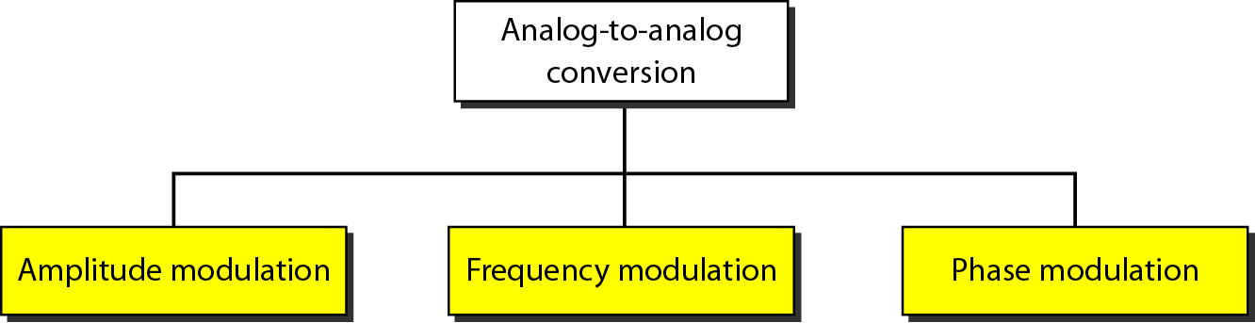
Types of analog-to-analog modulation

Slide 25
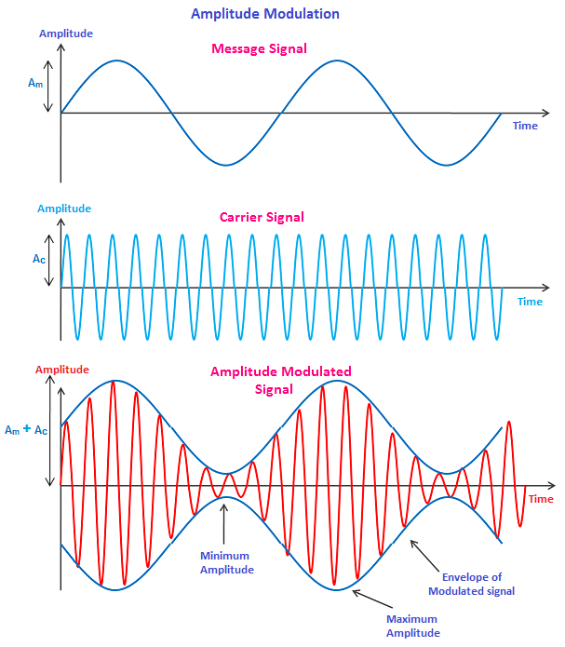
Amplitude Modulation
Amplitude modulation is a type of modulation where the amplitude (signal strength) of the carrier signal is varied in accordance with the amplitude (signal strength) of the message signal.
In amplitude modulation, only the amplitude of the carrier wave is changed while the frequency and phase of the carrier wave remain constant.

Slide 26
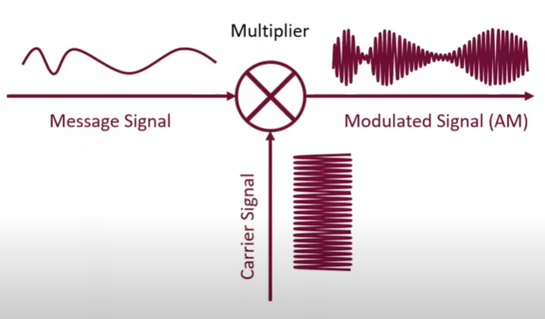
Amplitude Modulation

Slide 27
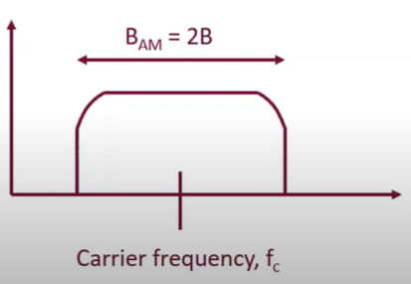
Amplitude Modulation Bandwidth
The modulation creates a bandwidth that is twice the bandwidth of the modulating signal and covers a range centered on the carrier frequency.
However, the signal components above and below the carrier frequency carry exactly the same information.

Slide 28
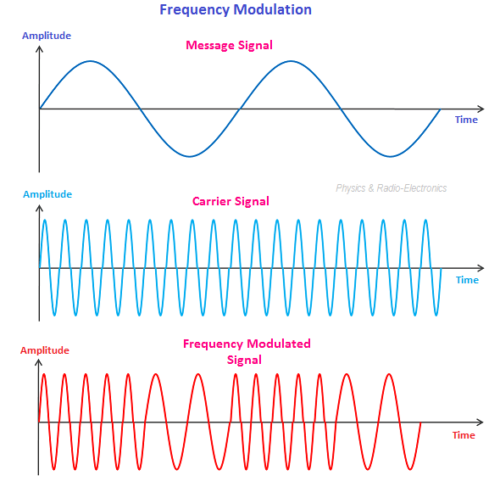
Frequency Modulation
Frequency modulation is a type of modulation where the information (message signal) is transmitted over a carrier wave by varying its frequency in accordance with the amplitude of the message signal.

Slide 29
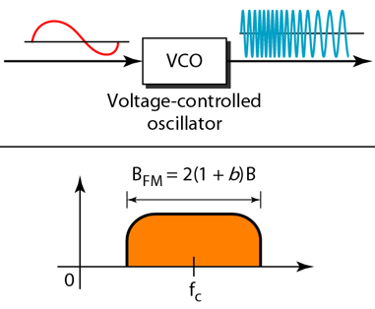

Frequency Modulation Bandwidth
The total bandwidth required for FM can be determined from the bandwidth of the audio signal: $B_{FM}$ = 2(1 + β)B. Where β is usually 4.

Slide 30
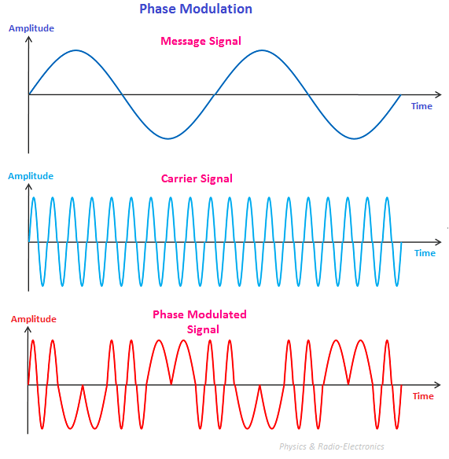
Phase Modulation (PM)
Phase modulation is a type of modulation where the phase of the carrier signal varies as per amplitude variations of the message signal.

Slide 31
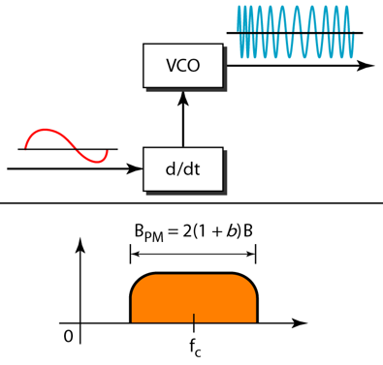
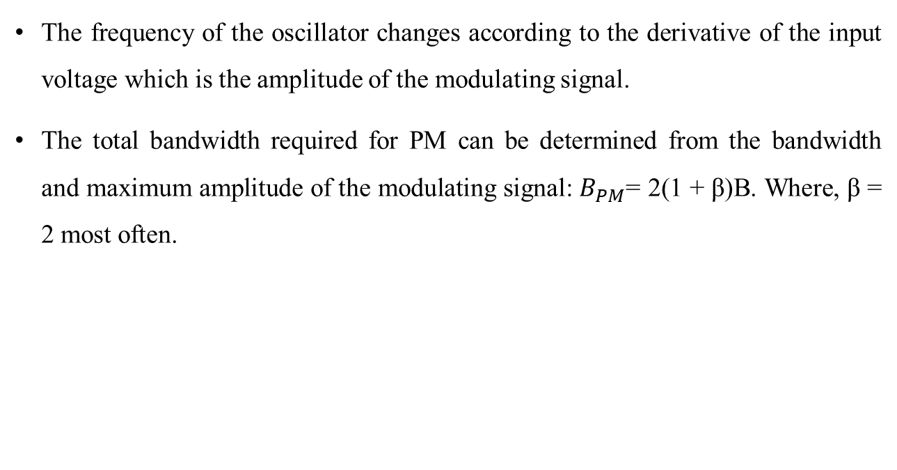
Phase Modulation (PM) Bandwidth
The frequency of the oscillator changes according to the derivative of the input voltage which is the amplitude of the modulating signal.
The total bandwidth required for PM can be determined from the bandwidth and maximum amplitude of the modulating signal: $B_{PM}$= 2(1 + β)B. Where, β = 2 most often.

